Slide 1
Artificial Intelligence (Spring-2023)
Local Search

Slide 2
Today’s Agenda
Beyond Classical Search
(Russell and Norvig: Chap. 4 [Section 4.1])

Slide 3
Slides taken from ...
Jean-Claude Latombe, Stanford University
Richard H. Lathrop, University of California
Pinar Duygulu, Bilkent University
Weng-Keen Wong, Oregonstate

Slide 4
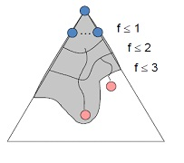
Systematic Search Review
Be able to formulate a problem as a search problem.
Tree Search vs. Graph Search
How they operate and expand nodes?
Queue (FIFO), Stack (LIFO), Priority Queue
Breadth-first search: f(n) = d(n)
Depth-first search : f(n) = - d(n)
Uniform-cost search: f(n) = g(n)
Greedy best-first search: f(n) = h(n)
A* search: f(n) = g(n) + h(n)

Slide 5
Systematic Search Review
Completeness?
Optimality?
Time Complexity?
Space Complexity?
How to construct heuristics?
Pros and Cons of various search methods, which method to use when?

Slide 6



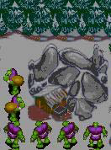
Tough Real-World Problems
Suppose you had to solve VLSI layout problems (minimize distance between components, unused space, etc.)…
Or schedule airlines…
Or schedule workers with specific skill
sets to do tasks that have resource
and ordering constraints

Slide 7

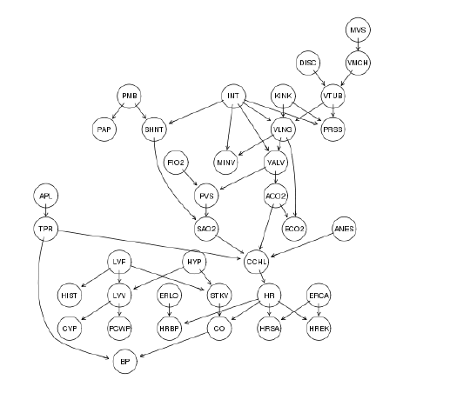
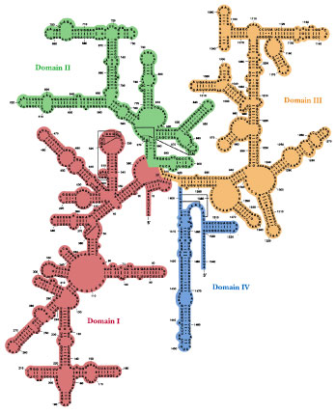
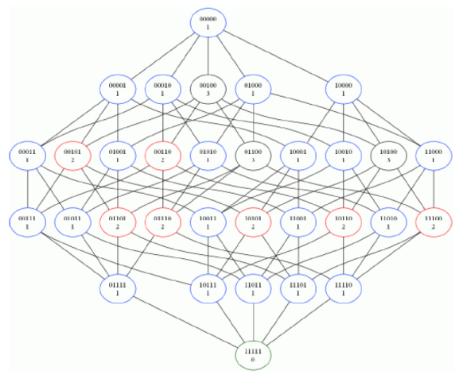
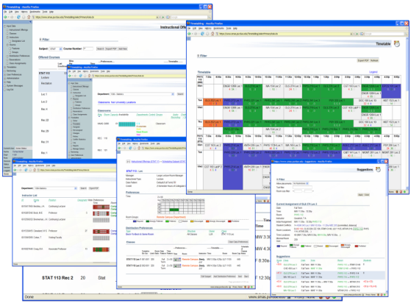
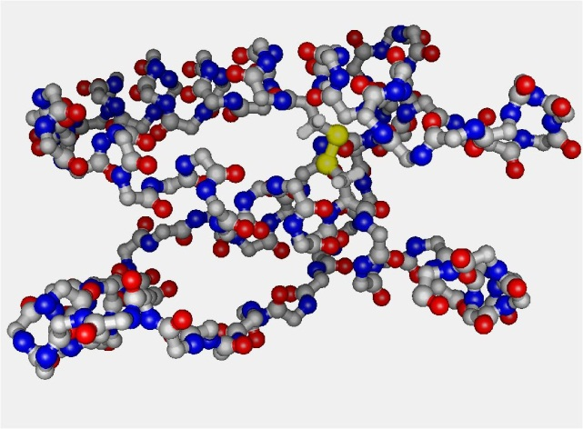
Tough Real-World Problems
Probabilistic Reasoning
Propositional Satisfiability (SAT)
RNA Structure Design
Scheduling of Hubble Space Telescope:
1 week → 10 seconds
University Timetabling
Protein Folding

Slide 8
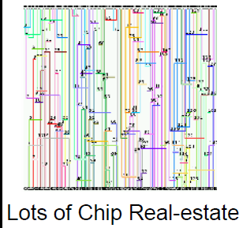
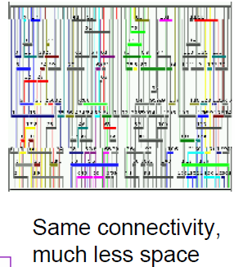
Tough Real-World Problems
Channel Routing

Slide 9
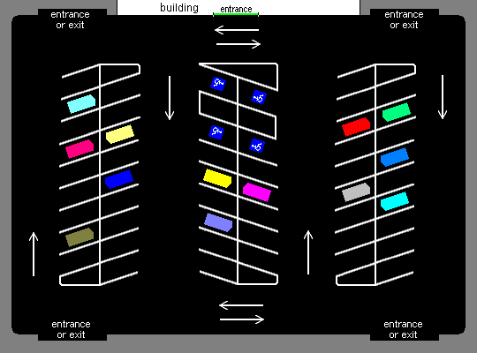
Tough Real-World Problems
Parking Lot Layout

Slide 10
What do these problems have in common?
These problems are unlike the systematic search problems
The path to the goal is irrelevant
all you care about is the final configuration
These are often optimization problems in which you find the best state according to an objective function
These problems are examples of local search problems

Slide 11
Local Search Problems
Given:
a set of states: S = {Xi, . . . . . . , Xm}
an objective function [Eval(Xi)] that returns the goodness of the state
Find the state X* that maximizes the objective function
The new state is close to the previous one in the space of states, hence the name local search.
[Note: Sometimes Eval(Xi) is a cost function instead of an objective function, in this case, we want to find the state X* that minimizes the cost function]

Slide 12
State-space landscape
A landscape has both:
“location” (defined by the state) and
“elevation” (defined by the value of the heuristic cost function or objective function).
Aim is to find
the lowest valley—a global minimum
to find the highest peak—a global maximum

Slide 13
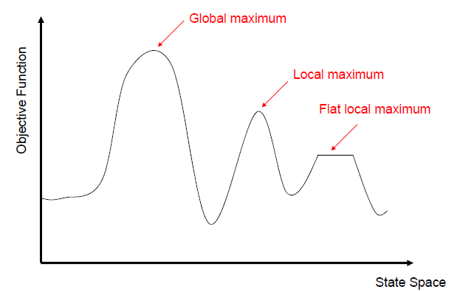
State-Space Landscape

Slide 14
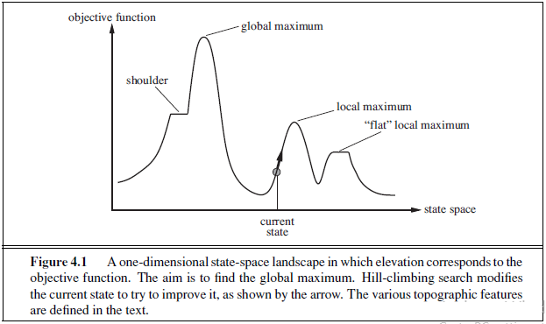

Slide 15
Local Search Algorithms
Local search algorithms have two key advantages:
they use very little memory—usually a constant amount; and
they can often find reasonable solutions in large or infinite (continuous) state spaces for which systematic algorithms are unsuitable.

Slide 16
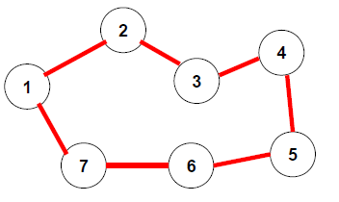
Example: Traveling Salesman Problem
State X = order of cities visited such that all cities are visited exactly once
Eval(X) = length of the tour defined by state X
Want to minimize the length of the tour

Slide 17
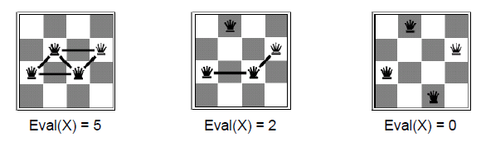
Example: n-queens
State X = placement of the queens on the board
Eval(X) = # of pairs of queens attacking each other
Want to minimize Eval(X)

Slide 18
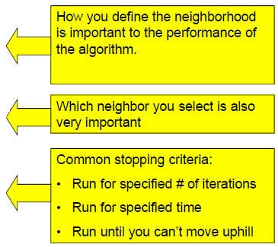
Local Search Algorithm Recipe
Start with initial configuration X
Evaluate its neighbors i.e., the set of all states reachable in one move from X
Select one of its neighbors X*
Move to X*
Repeat until the current configuration is satisfactory

Slide 19

Hill-climbing (Intuition)
“…resembles trying to find the top of Mount Everest in a thick fog while suffering from amnesia.”
Starting at initial state X, keep moving to the neighbor with the highest objective function value greater than X’s.

Slide 20
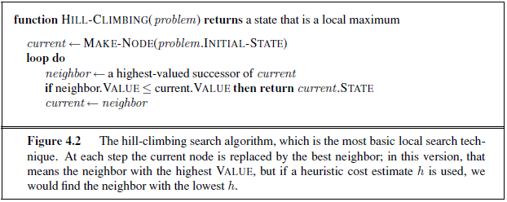

Slide 21
Hill-climbing Algorithm
X ← Initial configuration
Iterate:
E ← Eval(X)
N ← Neighbors(X)
For each Xi in N
Ei ← Eval(Xi)
E* ← Highest Ei
X* ← Xi with highest Ei
If E* > E
X ← X*
Else
Return X

Slide 22
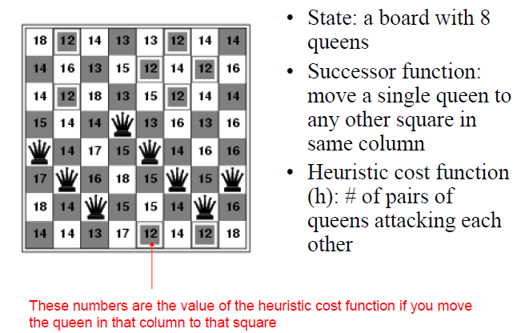
Example-1: 8-queens

Slide 23
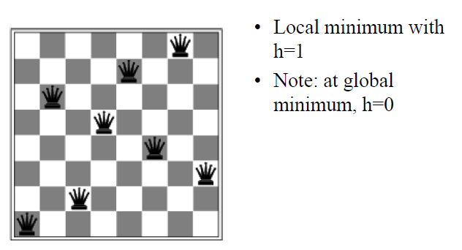
Example-1: 8-queens

Slide 24
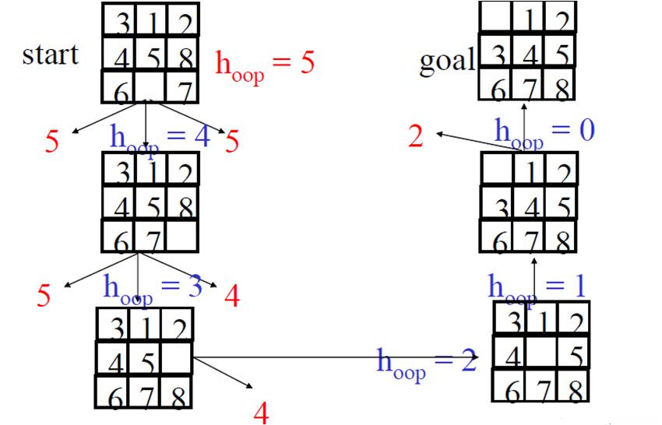
Example-2: 8-puzzle

Slide 25
More on Hill-climbing
Hill-climbing also called greedy local search
Greedy because it takes the best immediate move
Greedy algorithms often perform quite well

Slide 26
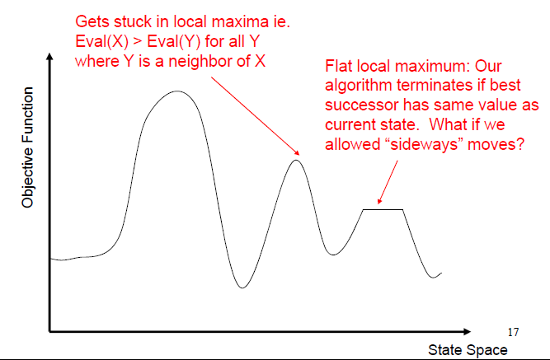
Problems with Hill-climbing (Local Maxima and Plateau)

Slide 27
Local maxima: a local maximum is a peak that is higher than each of its neighboring states but lower than the global maximum. Hill-climbing algorithms that reach the vicinity of a local maximum will be drawn upward toward the peak but will then be stuck with nowhere else to go.
Plateaux: a plateau is a flat area of the state-space landscape. It can be a flat local maximum, from which no uphill exit exists, or a shoulder, from which progress is possible.

Slide 28

Ridges

Slide 29
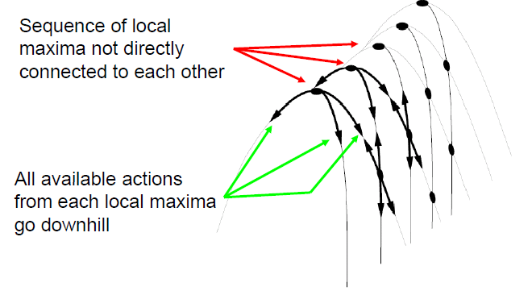
Problems with Hill-climbing (Ridges)

Slide 30
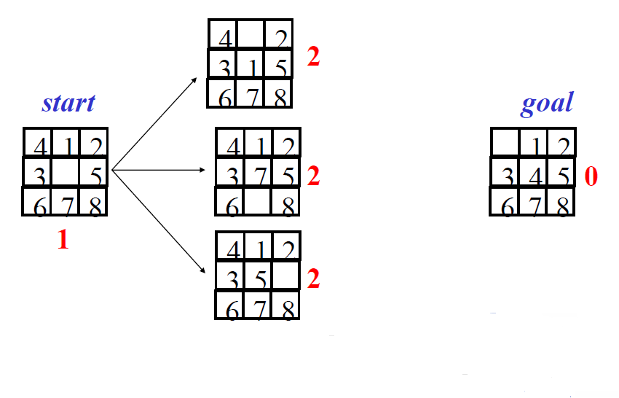
Example: 8-puzzle (local maxima)

Slide 31


Slide 32
Variants of Hill-climbing
Stochastic hill climbing:
Chooses at random among the uphill moves
Probability of selection varies with steepness
This usually converges more slowly than steepest ascent.
First-choice hill climbing:
Implements stochastic but generates successors randomly until one is generated that is better than the current state
Good when state has many successors (thousands).
Random-restart hill-climbing
Good for dealing with local maxima
Conduct a series of hill-climbing searches from randomly generated initial states
Stop when a goal state is found (or until time runs out, in which case return the best state found so far)

Slide 33
Random restart
“If at first you don’t succeed, try, try again.”
Randomly generated initial states. (So Complete)
If each hill-climbing search has a probability p of success, then the expected number of restarts required is 1/p.
For 8-queens instances with no sideways moves allowed, p ≈ 0.14, so we need roughly 7 iterations to find a goal (6 failures and 1 success).

Slide 34
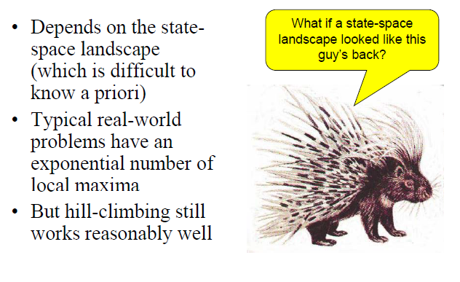
Which Variant?

Slide 35
Simulated Annealing
Hill-climbing never makes a downhill move
What if we added some random moves to hill-climbing to help it get out of local maxima?
This is the motivation for simulated annealing
[Note: Annealing refers to the process used to harden metals and glass by heating them to a high temperature and then gradually cooling them]

Slide 36
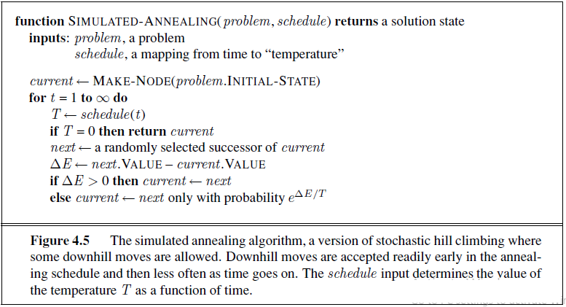

Slide 37
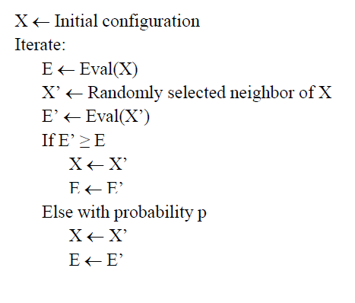
Simulated Annealing Algorithm

Slide 38
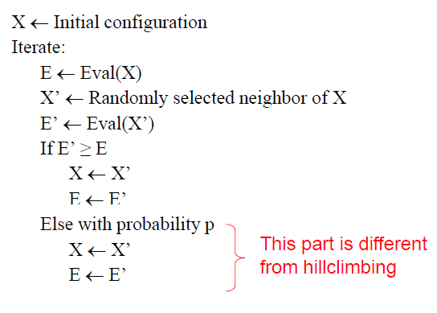
Simulated Annealing Algorithm

Slide 39
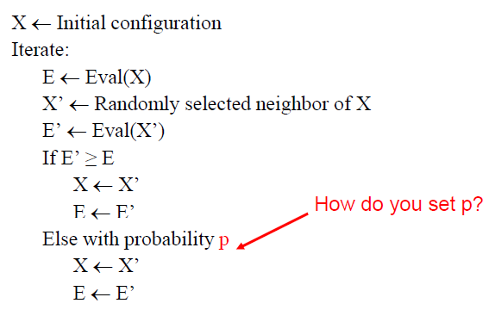
Simulated Annealing Algorithm

Slide 40
Setting p
What if p is too low?
We don’t make many downhill moves and we might not get out of many local maxima
What if p is too high?
We may be making too many suboptimal moves
Should p be constant?
We might be making too many random moves when we are near the global maximum

Slide 41
Setting p
Decrease p as iterations progress
Accept more downhill moves early accept fewer Setting p early, as search goes on
Intuition: as search progresses, we are moving towards more promising areas and quite likely toward a global maximum
Decrease p as E – E’ increases
Accept fewer downhill moves if slope is high
See next slide for intuition

Slide 42
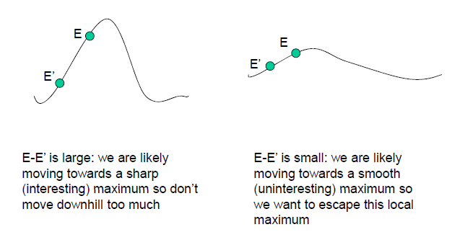
Decreasing p as E-E’ increases

Slide 43

Setting p
Needs a temperature parameter T
If E’ ≤ E, accept the downhill move with probability p =
Start with high temperature T, (more downhill moves allowed at the start)
Decrease T gradually as iterations increase (less downhill moves allowed)
Annealing schedule describes how T is decreased at each step

Slide 44
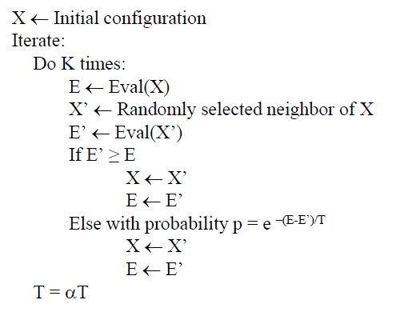
Complete Simulated Annealing Algorithm

Slide 45
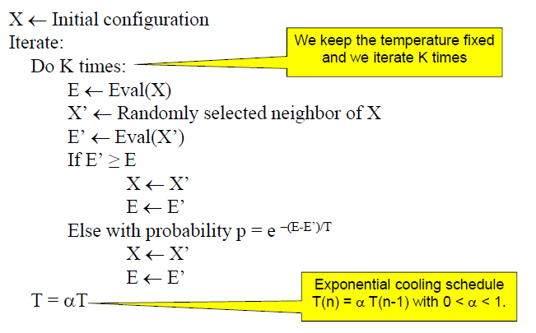
Complete Simulated Annealing Algorithm

Slide 46
Convergence
If the schedule lowers T slowly enough, the algorithm will find a global optimum with probability approaching 1
In practice, reaching the global optimum could take an enormous number of iterations

Slide 47
The fine print…
Design of neighborhood is critical
Lots of parameters to tweak e.g., α, K, initial temperature
Simulated annealing is usually better than hill-climbing if you can find the right parameters

Slide 48
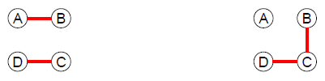
Local Beam Search
Travelling Salesman Problem
Keeps track of k states rather than just 1.
k = 2 in this example. Start with k randomly generated states.

Slide 49
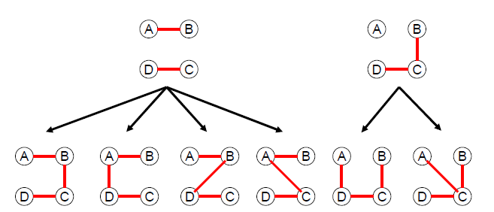
Local Beam Search: Example
Travelling Salesman Problem (k=2)
Generate all successors of all the k states

Slide 50
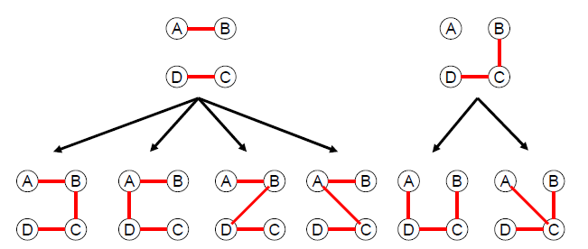
Local Beam Search: Example
Travelling Salesman Problem (k=2)
None of these is a goal state so we continue

Slide 51
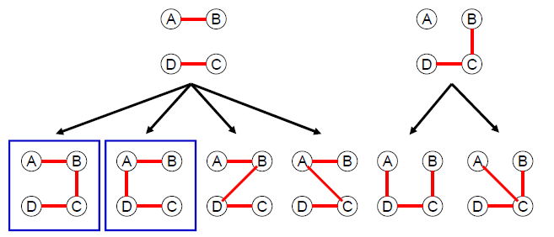
Local Beam Search: Example
Travelling Salesman Problem (k=2)
Select the best k successors from the complete list

Slide 52
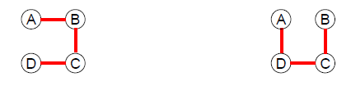
Local Beam Search: Example
Travelling Salesman Problem (k=2)
Repeat the process until goal found

Slide 53
Local Beam Search
How is this different from k random restarts in parallel?
Random-restart search: each search runs independently of the others
Local beam search: useful information is passed among the k parallel search threads
e.g.; One state generates good successors while the other k-1 states all generate bad successors, then the more promising states are expanded

Slide 54
Local Beam Search
Disadvantage: all k states can become stuck in a small region of the state space
To fix this, use stochastic beam search
Stochastic Beam Search:
Doesn’t pick best k successors
Chooses k successors at random, with probability of choosing a given successor being an increasing function of its value

Slide 55
Genetic Algorithms
Like natural selection in which an organism creates offspring according to its fitness for the environment
Essentially a variant of stochastic beam search that combines two parent states (just like natural reproduction)
Over time, population contains individuals with high fitness

Slide 56
GAs begin with a set of k randomly generated states, called the population. Each state, or individual, is represented as a string over a finite alphabet.

Slide 57
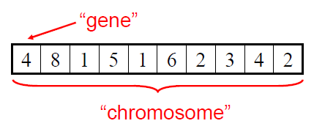
Definitions
Fitness function: Evaluation function in GA terminology
Population: k randomly generated states (called individuals)
Individual: String over a finite alphabet

Slide 58
Like stochastic beam search, genetic algorithms combine an uphill tendency with random exploration and exchange of information among parallel search threads.
The primary advantage, if any, of genetic algorithms comes from the crossover operation.
Intuitively, the advantage comes from the ability of crossover to combine large blocks of letters that have evolved independently to perform useful functions, thus raising the level of granularity at which the search operates.

Slide 59
The theory of genetic algorithms explains how this works using the idea of a schema, which is a substring in which some of the positions can be left unspecified. For example, the schema 246***** describes all 8-queens states in which the first three queens are in positions 2, 4, and 6, respectively. Strings that match the schema (such as 24613578) are called instances of the schema. It can be shown that if the average fitness of the instances of a schema is above the mean, then the number of instances of the schema within the population will grow over time.

Slide 60
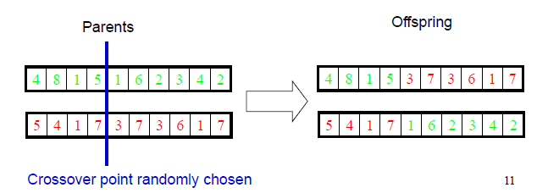
Definitions
Selection: Pick two random individuals for reproduction
Crossover: Mix the two parent strings at the crossover point

Slide 61
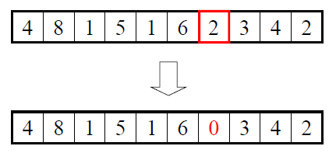
Definitions
Mutation: randomly change a location in an individual’s string with a small independent probability
Randomness aids in avoiding small local extrema

Slide 62
GA Overview
Population = Initial population
Iterate until some individual is fit enough or enough time has
elapsed:
NewPopulation = Empty
For 1 to size(Population)
Select pair of parents (P1,P2) using Selection(P,Fitness Function)
Child C = Crossover(P1, P2)
With small random probability, Mutate(C)
Add C to NewPopulation
Population = NewPopulation
Return individual in Population with best Fitness Function

Slide 63
GA Overview
Population = Initial population
Iterate until some individual is fit enough or enough time has
elapsed:
NewPopulation = Empty
For 1 to size(Population)
Select pair of parents (P1,P2) using Selection(P,Fitness Function)
Child C = Crossover(P1, P2)
With small random probability, Mutate(C)
Add C to NewPopulation
Population = NewPopulation
Return individual in Population with best Fitness Function
This pseudocode only produces one
child. Could also do a variant like
before where we produce 2 children

Slide 64
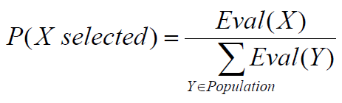
Lots of variants
Variant1: Culling - individuals below a certain threshold are removed
Variant2: Selection based on:

Slide 65
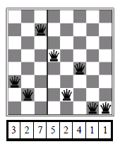
Example: 8-queens
Fitness Function: number of nonattacking pairs of queens (28 is the value for the solution)
Represent 8-queens state as an 8 digit string in which each digit represents position of queen

Slide 66
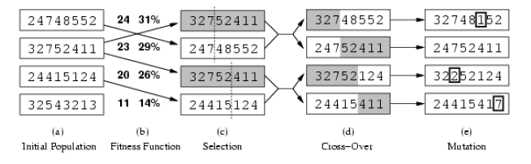
Example: 8-queens

Slide 67
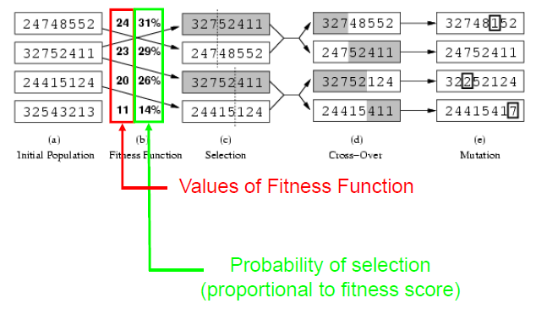
Example: 8-queens (Fitness Function)

Slide 68
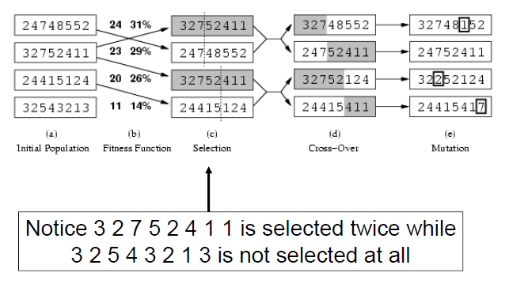
Example: 8-queens (Selection)

Slide 69
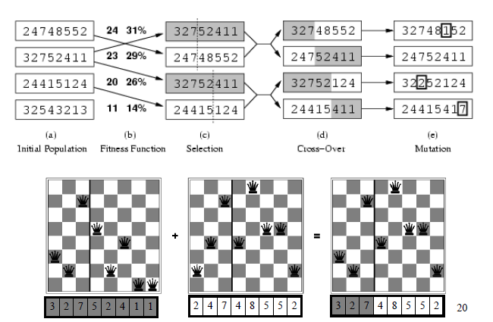
Example: 8-queens (Crossover)

Slide 70
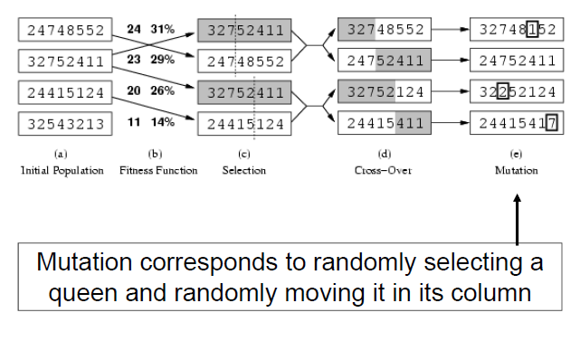
Example: 8-queens (Mutation)

Slide 71
Implementation details on GA
Initially, population is diverse and crossover produces big changes from parents
Over time, individuals become quite similar and crossover doesn’t produce such a big change
Crossover is the big advantage:
Preserves a big block of “genes” that have evolved independently to perform useful functions
e.g.; Putting first 3 queens in positions 2, 4, and 6 is a useful block

Slide 72
The fine print…
The representation of each state is critical to the performance of the GA
Lots of parameters to tweak but if you get them right, GAs can work well
Limited theoretical results (skeptics say it’s just a big hack)

